Slide 1


Minnesota Interstate traffic volume An in-depth analysis ofinterstate traffic patterns on our highways

Slide 2
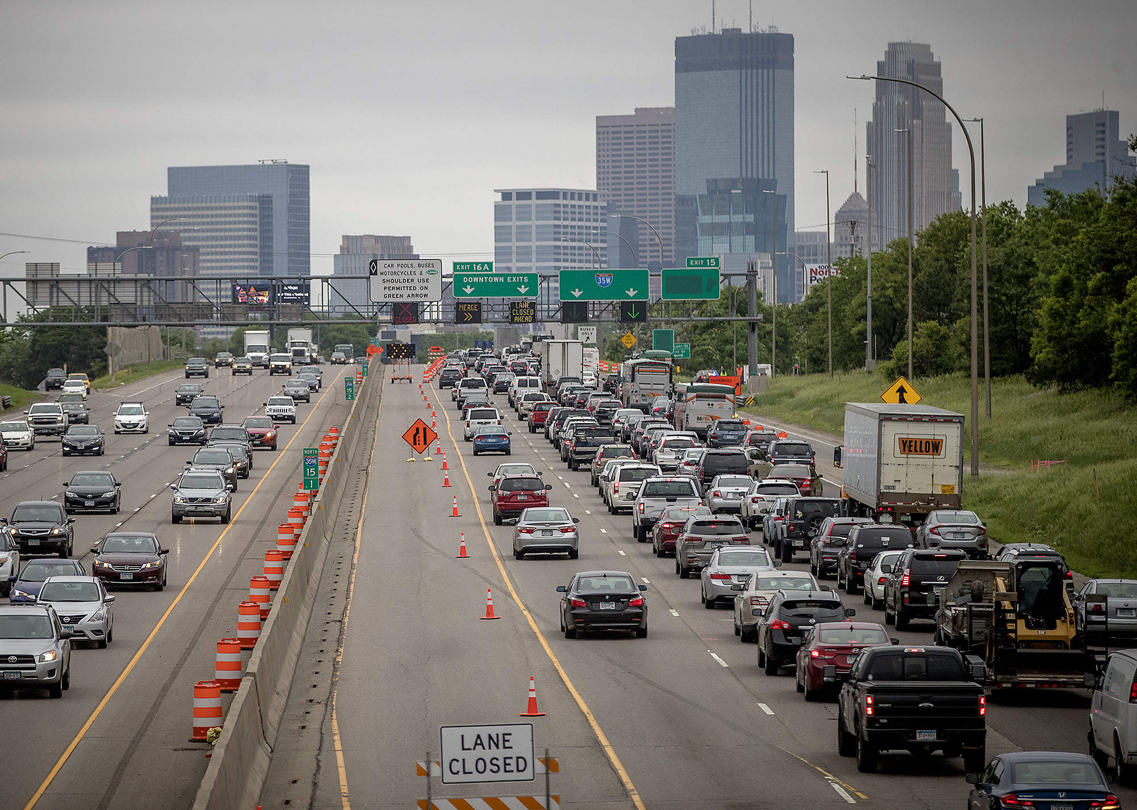
Interstate traffic congestion continues to grow worse for the foreseeable future…

Slide 3

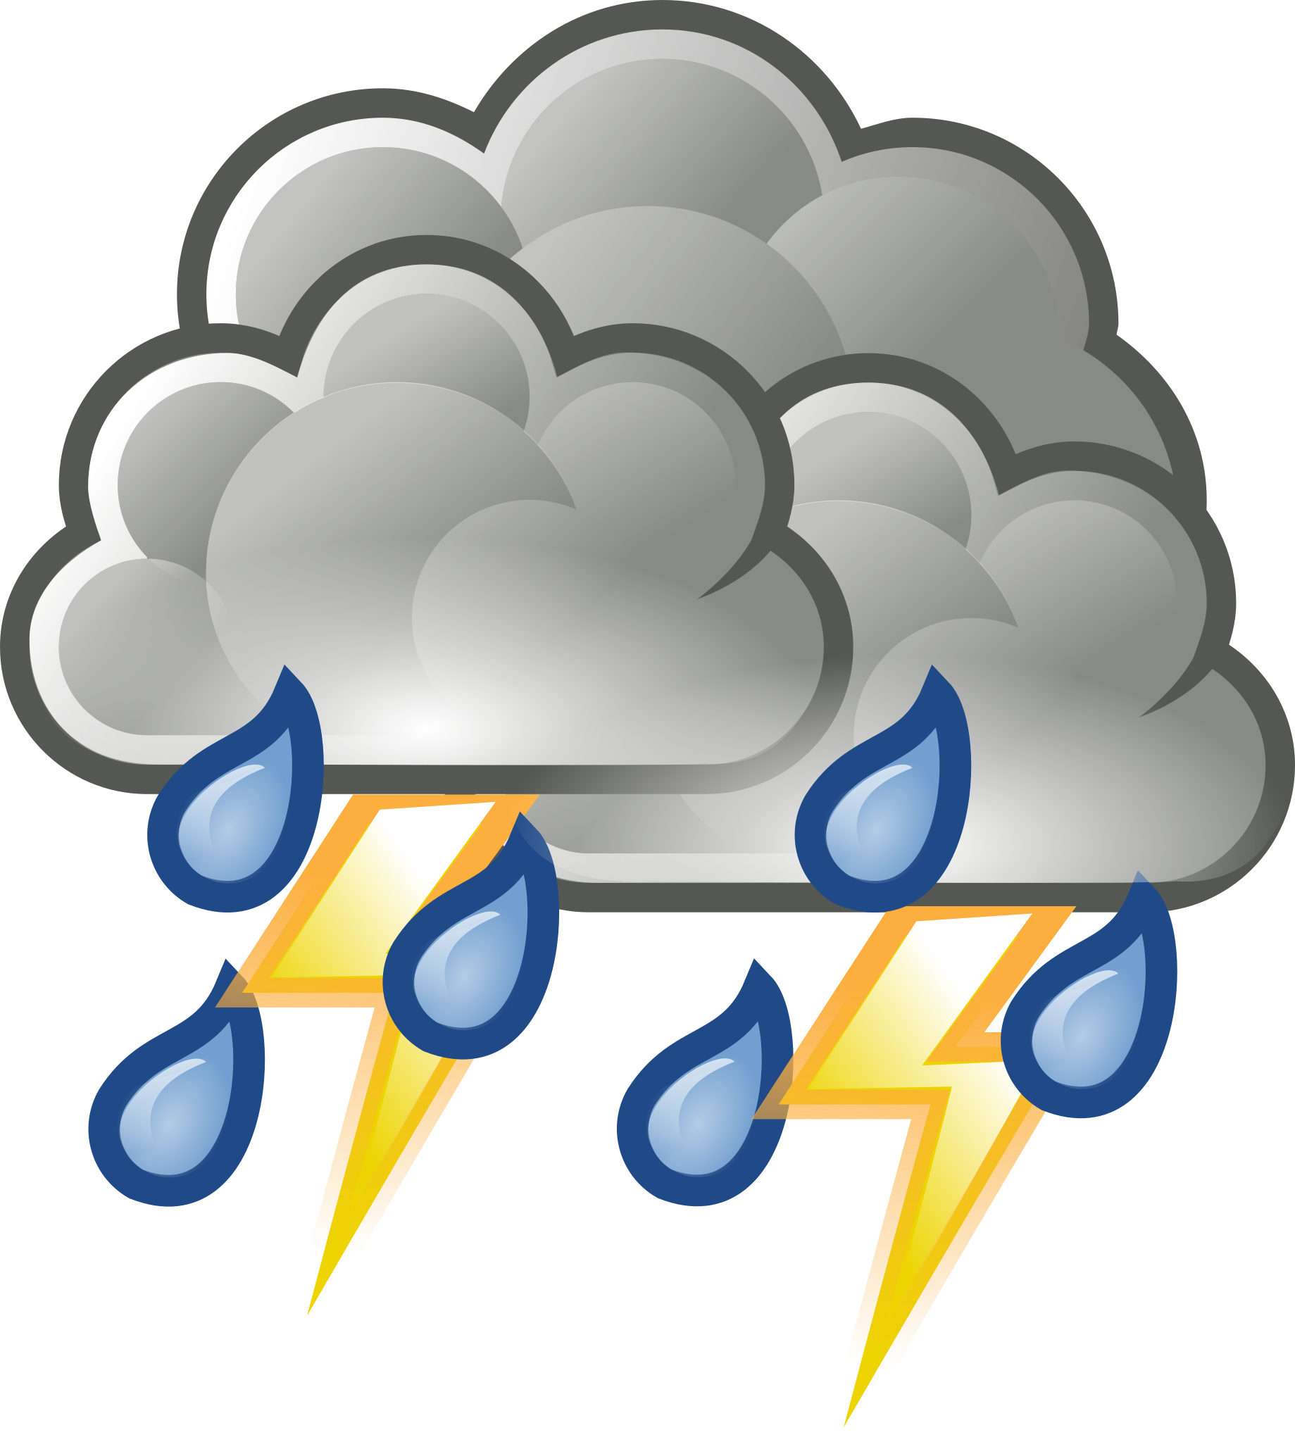
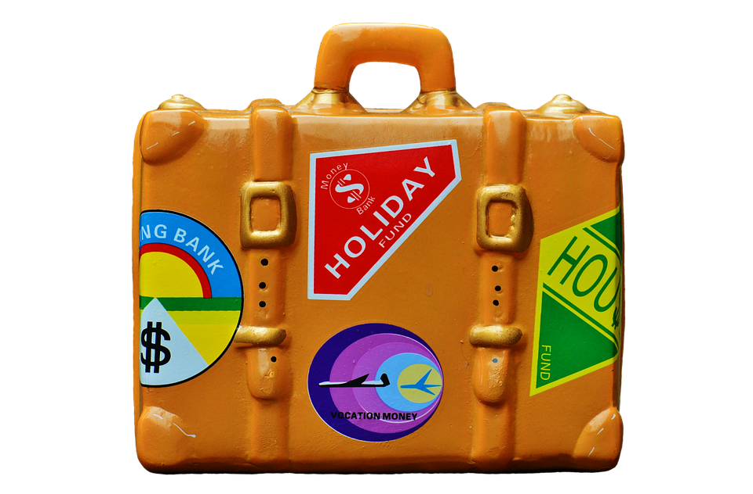
Analyzing the data in 3 distinct charts
Monthly Volumes
Viewing the monthly traffic patterns allows us to find any potential trends by month.
Weather
Weather can have an impact on many things, including traffic.
Holiday Travel
Our roads may see more travelers (including out of state) than expected.

Slide 4
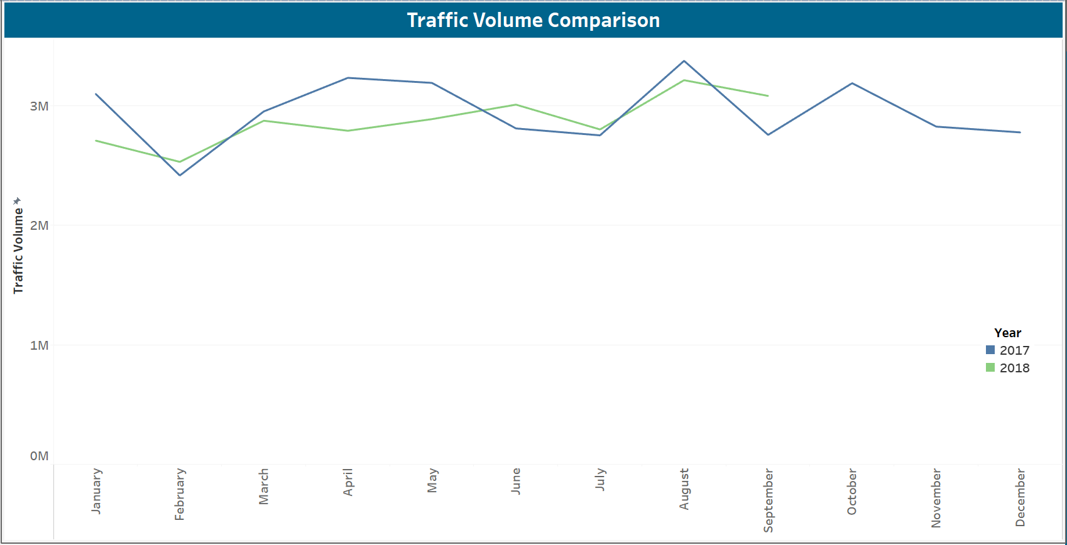
Monthly Interstate Traffic Volumes
August - Highest volume, likely due to end of summer seasonal traffic
February – Lowest volume, best potential month for construction improvements
April – Significant decrease in volume in 2018
Relatively consistent & predictable traffic patterns

Slide 5
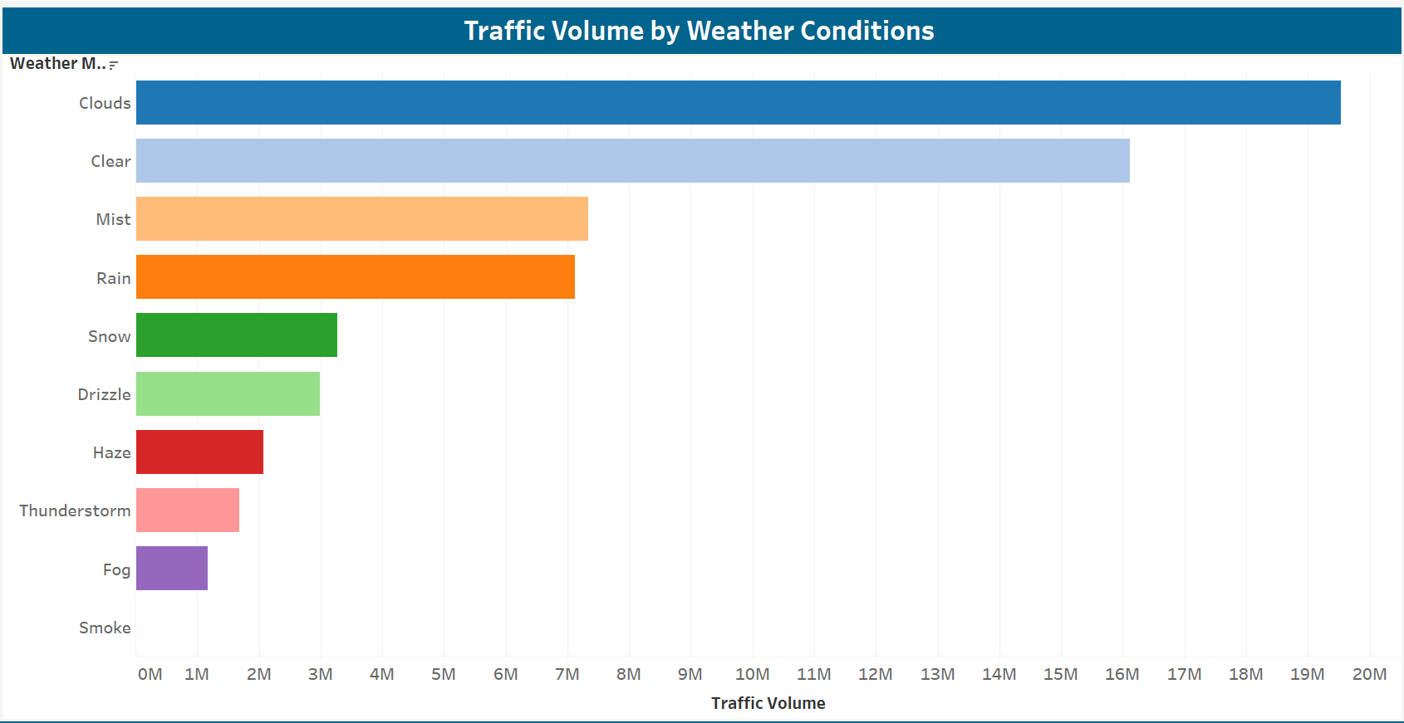
Role of weather on traffic volume
Clear/Cloudy Conditions – Highest traffic volume.
Low-Visibility Conditions – Lowest traffic volume.
Precipitation Conditions – Significant impact on traffic volume, however, still a high number of motorists driving on rainy days.
What can be done to alleviate traffic delays on rainy days?

Slide 6
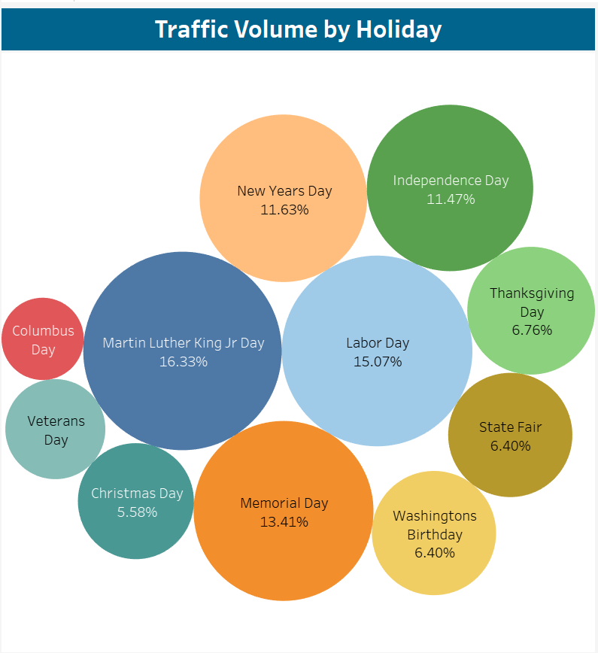
Holiday travel
August – High traffic due to State Fair and end of summer travel.
January – High traffic due to New Years and MLK Jr. holidays.
Majority of holidays seem to have little impact on overall traffic volume.

Slide 7
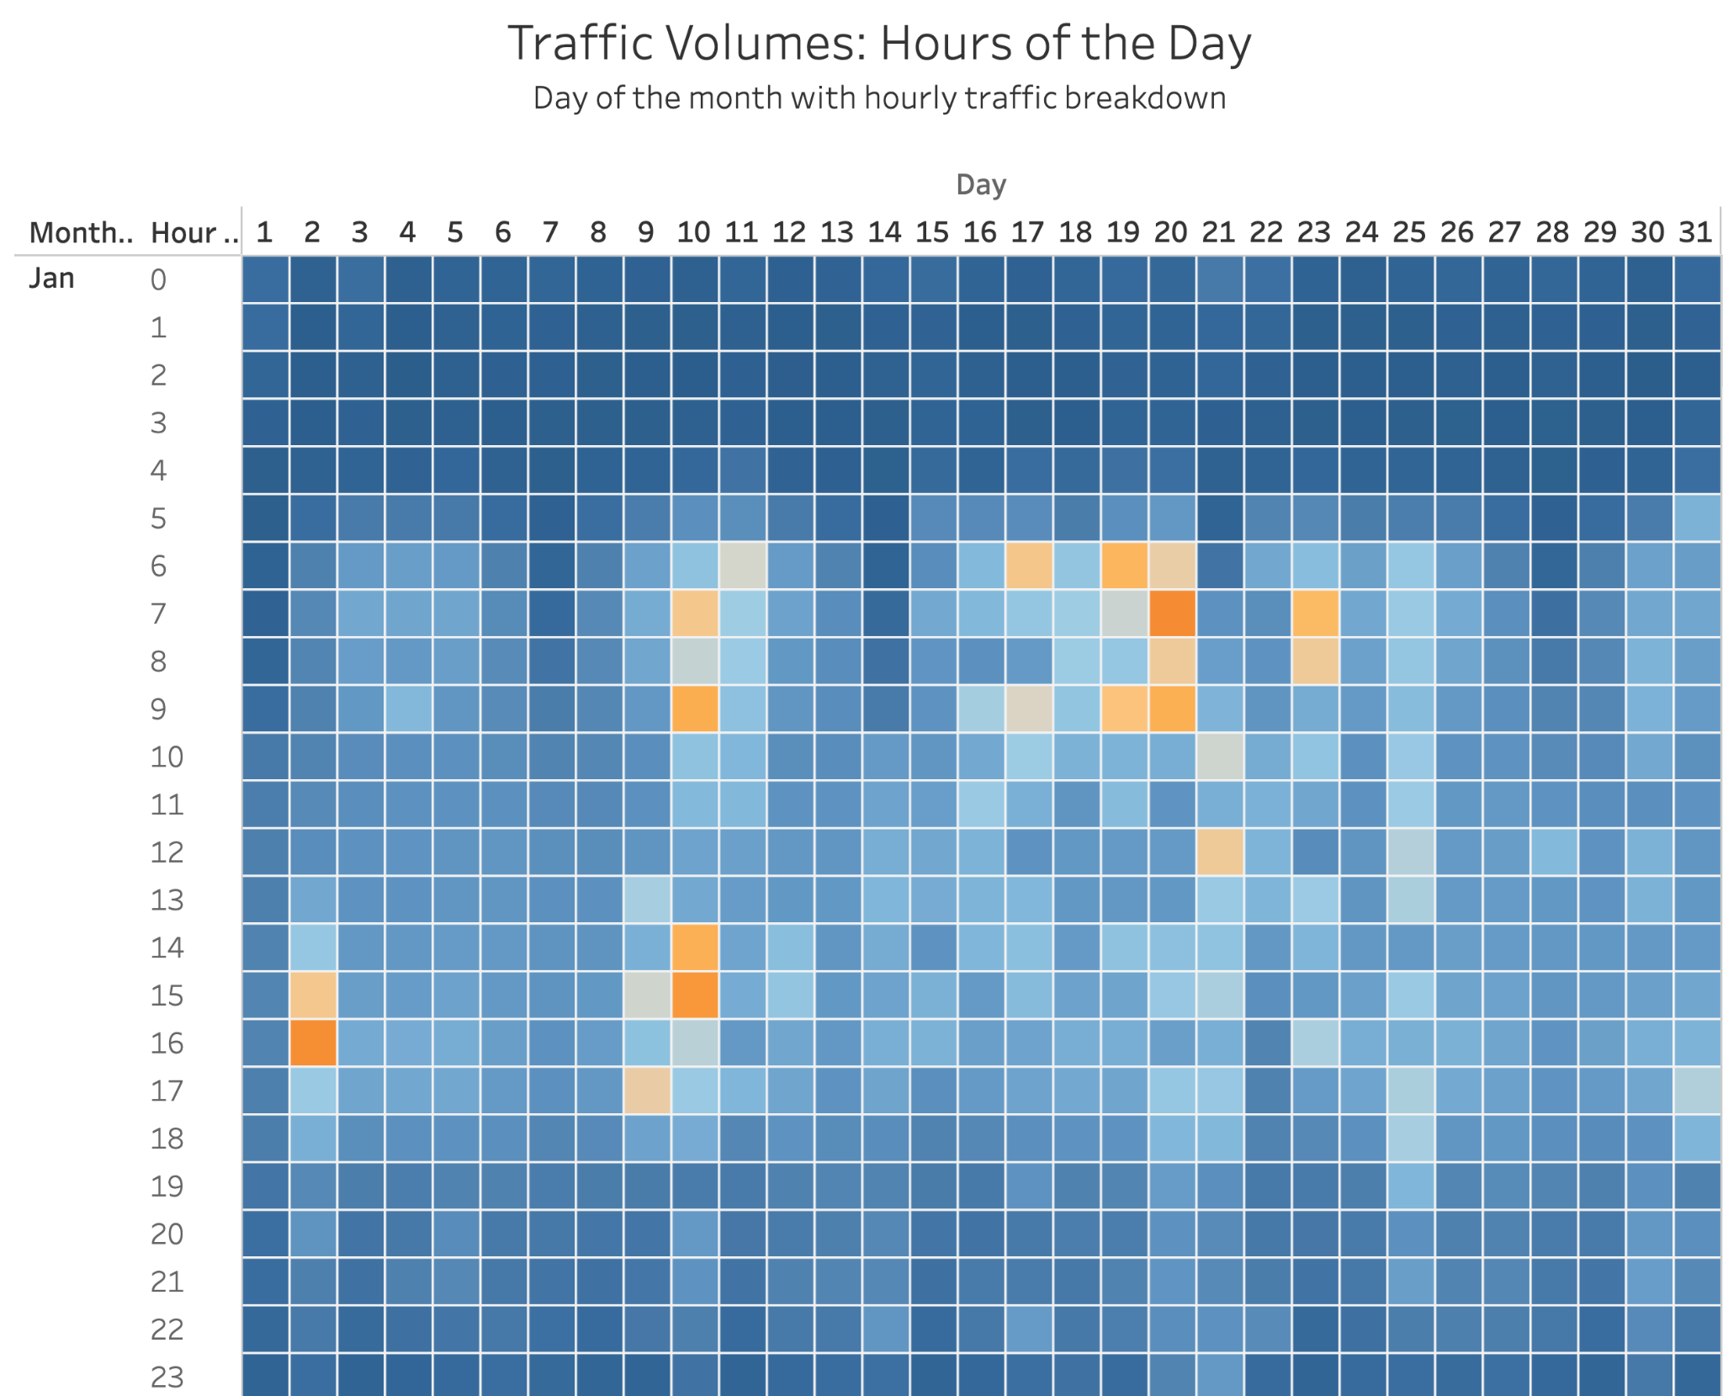
Hourly Traffic
Patterns reflected – busiest travel times: rush hours to and from work.
Days with Holiday – Does not reflect a significantly higher or lower traffic volume throughout the day.
Holiday travel does not impact hourly traffic volume.

Slide 8
Recommendations

Slide 9

THANK YOU Questions?
Eric Kingery
502-555-0152
brita@firstupconsultants.com
www.firstupconsultants.com

